Slide 1
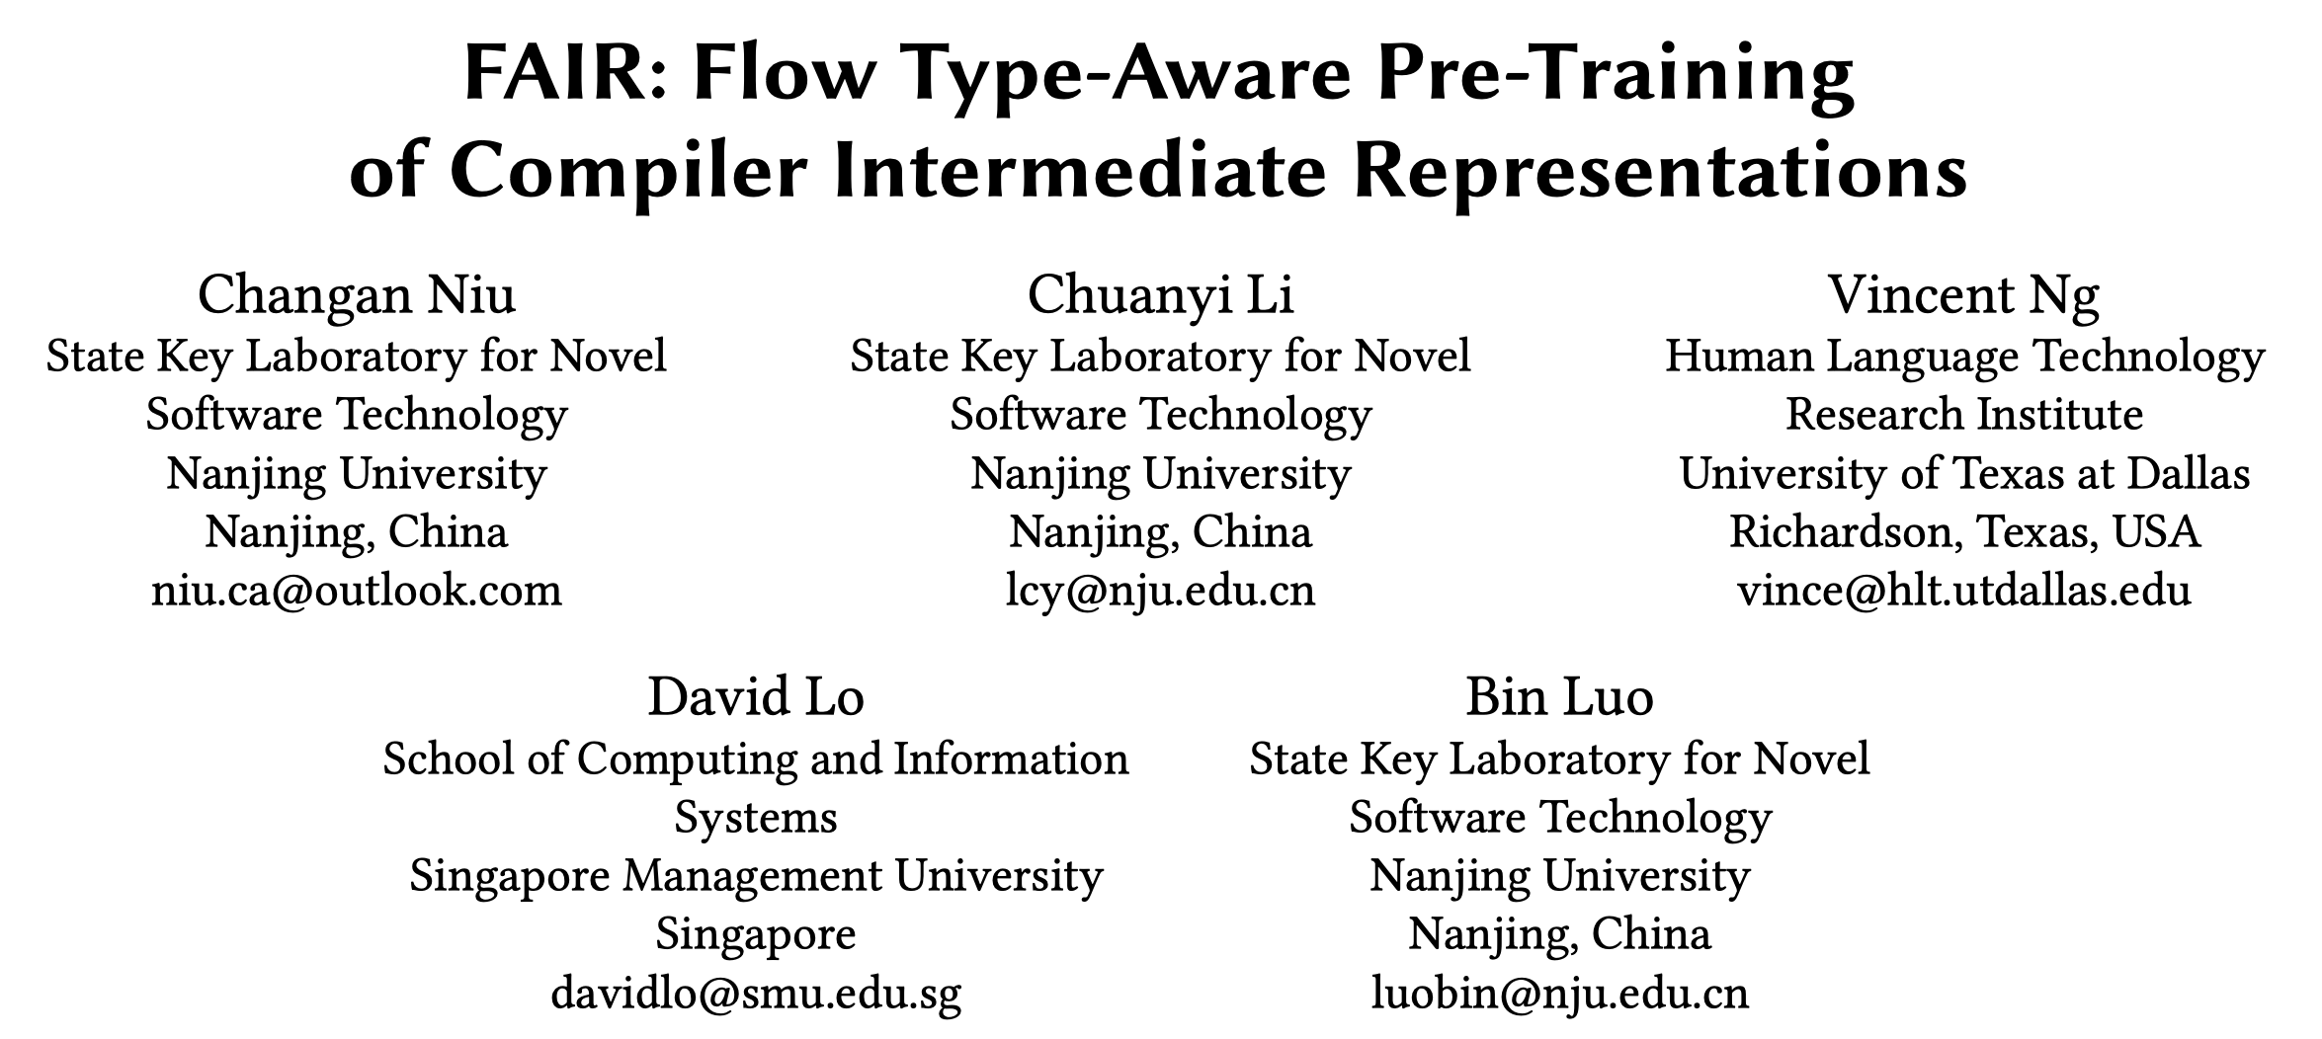
ICSE 2024

Slide 2
Abstract
Motivation
Existing pre-trained code representation models focus on high-level programming languages.
Intermediate representations (IRs)
Contribution
A heterogeneous graph for representing IRs
A pre-trained representation model for IRs, named FAIR

Slide 3
Background
Pre-trained Code Representation Models
High-level programming languages (PLs), e.g., Python, Java
E.g., CodeBERT, CodeT5
Intermediate Representations (IRs)
E.g., LLVM
Consistent syntax, Platform independence
A more concise, uniform, and efficient representation than PLs

Slide 4
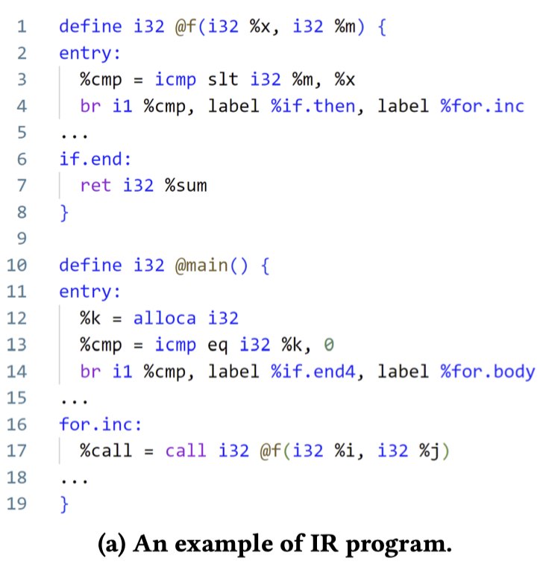
Background
Pre-trained Code Representation Models
High-level programming languages (PLs), e.g., Python, Java
E.g., CodeBERT, CodeT5
Intermediate Representations (IRs)
E.g., LLVM
Consistent syntax, Platform independence
A more concise, uniform, and efficient representation than PLs

Slide 5
Related Work
Token Sequences
BERT-Style Language Models
E.g., OSCAR (ICML 2021)
Token Sequences + Graphs 🚀🚀
Control Flow Graphs (CFGs), Data Flow Graphs (DFGs)
Graph Neural Networks (GNNs)
E.g., Programl (ICML 2021)

Slide 6
Challenge ①
CFGs and DFGs should be heterogeneous
Node
CFGs: entry, if, for, …
DFGs: variable
Edge
CFGs: jump based on conditions
DFGs: additive, divisive, …
🧗‍♂️
Heterogeneous CFGs and DFGs

Slide 7
Related Work
CFGs and DFGs are very large, containing more than a thousand nodes/flows.
Over-smoothing and over-squashing in GNNs
🧗‍♂️
Graph Transformer and Five pre-training tasks

Slide 8
FAIR
Flow type-Aware code pre-trained model based on IR
Input Representation
CFG, DFG, BB-Var Flows
Model Architecture
Node Embedding, Encoder
Pre-training Tasks
MLM, CFG/DFG Flow Type Prediction, Contrastive Learning

Slide 9
FAIR
Flow type-Aware code pre-trained model based on IR
Input Representation
CFG, DFG, BB-Var Flows
Model Architecture
Node Embedding, Encoder
Pre-training Tasks
MLM, CFG/DFG Flow Type Prediction, Contrastive Learning
👈

Slide 10
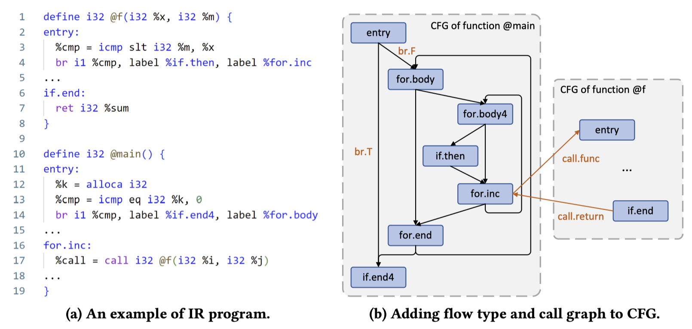

Input Representation ①
CFG with Flow Type
A standard CFG
Adding Flow Types
Adding Call Graphs
Basic Block

Slide 11
Input Representation ①
CFG with Flow Type
A standard CFG
Adding Flow Types
Adding Call Graphs
👉

Slide 12
Input Representation ①
CFG with Flow Type
A standard CFG
Adding Flow Types
Adding Call Graphs

Slide 13
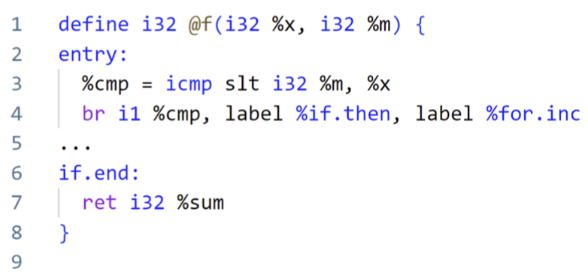
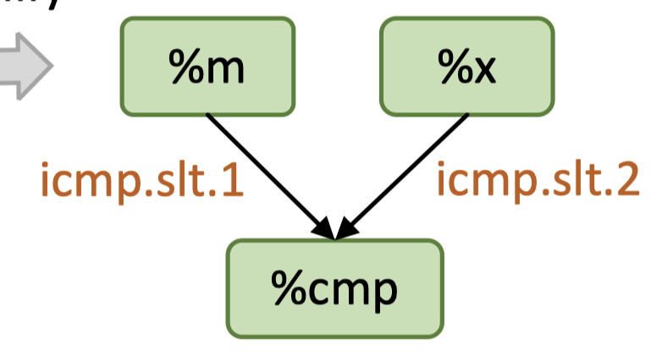
Input Representation ②
DFG with Flow Type
A standard DFG
Adding Flow Types
Adding Call Graphs
Variable

Slide 14
Input Representation ②
DFG with Flow Type
A standard DFG
Adding Flow Types
Adding Call Graphs
Variable
Opcodes: icmp (integer comparison)
Options: slt (signed less than)
Operand positions: 1/2

Slide 15

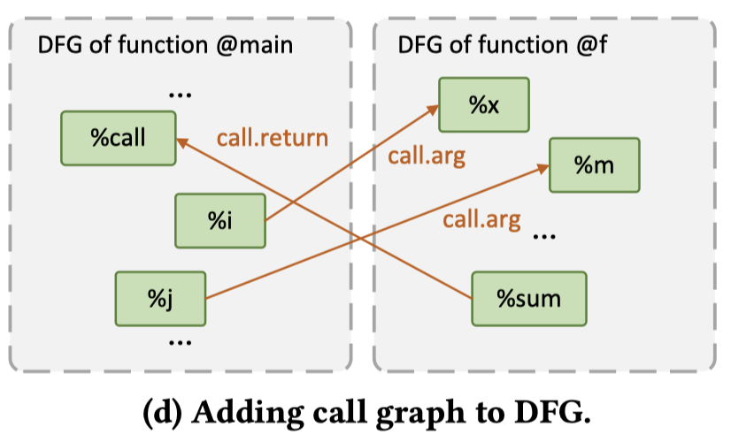
Input Representation ②
DFG with Flow Type
A standard DFG
Adding Flow Types
Adding Call Graphs

Slide 16
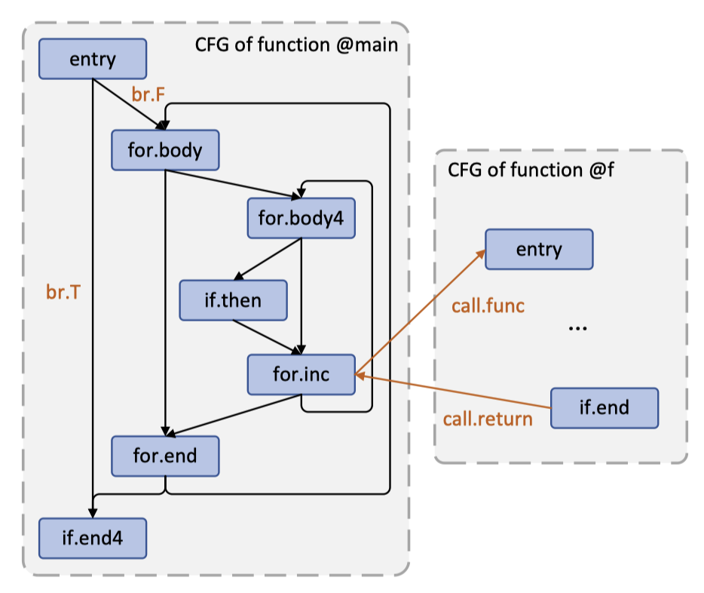
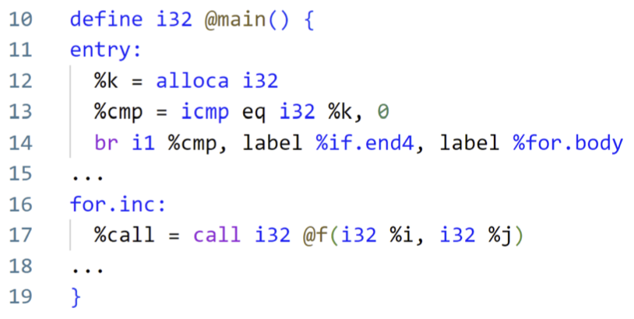
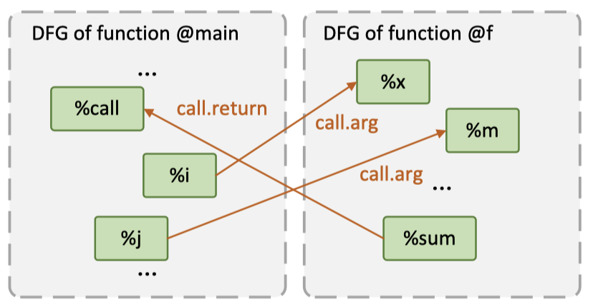
Input Representation ③
Basic Block-Variable Flows
CFGs and DFGs
Adding flows between basic blocks and variables

Slide 17
Input Representation

Slide 18
FAIR
Flow type-Aware code pre-trained model based on IR
Input Representation
CFG, DFG, BB-Var Flows
Model Architecture
Node Embedding, Encoder
Pre-training Tasks
MLM, CFG/DFG Flow Type Prediction, Contrastive Learning
👈

Slide 19
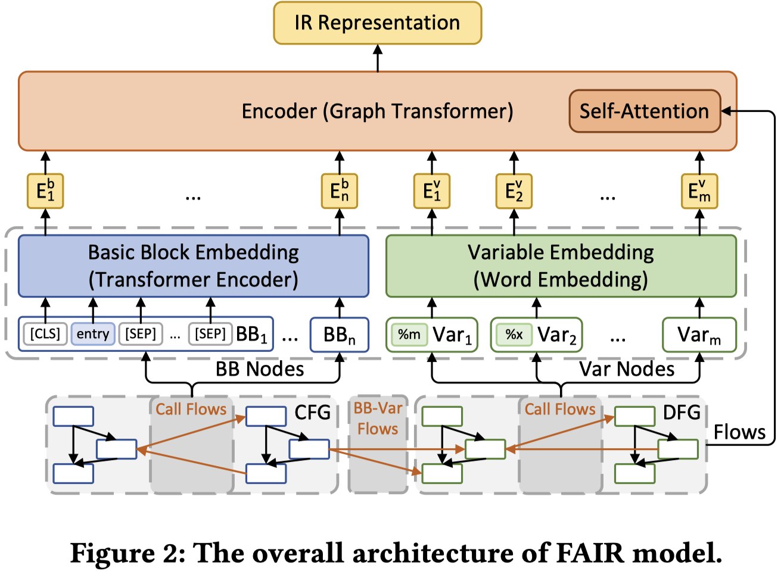
Model Architecture
Graph Transformer Encoder:
Node Embeddings ->
IR Representation
Node Embedding Layer:
Node -> Embedding
Inputs:
Tokens, CFGs, DFGs

Slide 20
Model Architecture
Node Embedding Layer
Node in CFGs -> A Transformer Encoder
Notes:
之后，作者为每一个编程任务撰写一个skeleton。Skeleton可以看做是目标类的一个结构化蓝图，其中包含了目标类的信息和成员方法的信息。
表2中展示了具体细节。

Slide 21
Model Architecture
Node Embedding Layer
Nodes in DFGs -> A Word Embedding Layer
Notes:
之后，作者为每一个编程任务撰写一个skeleton。Skeleton可以看做是目标类的一个结构化蓝图，其中包含了目标类的信息和成员方法的信息。
表2中展示了具体细节。

Slide 22
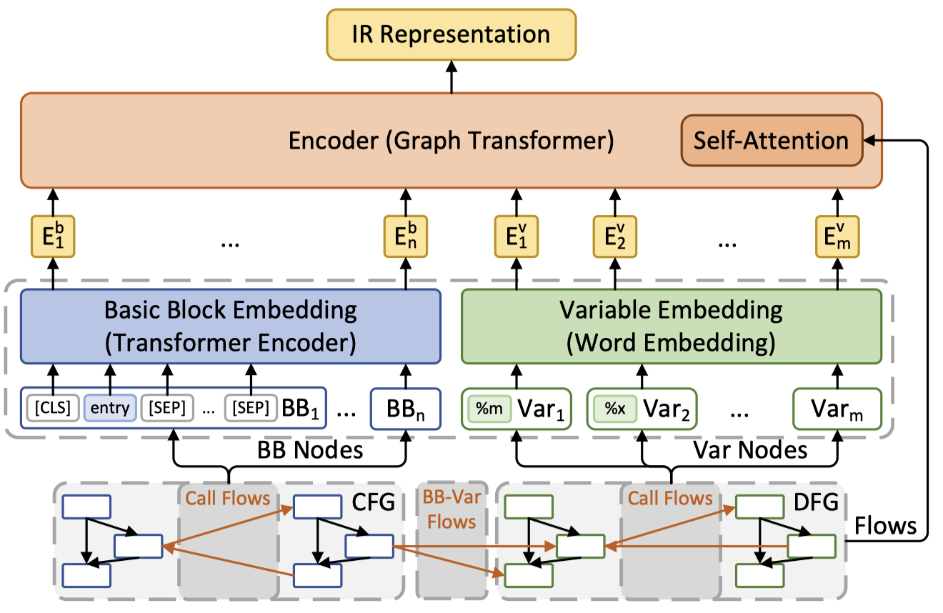
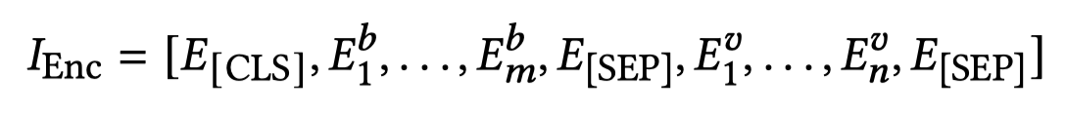
Model Architecture
Graph Transformer Encoder
Input Representation
Notes:
图2是一个class skeleton的示例。

Slide 23
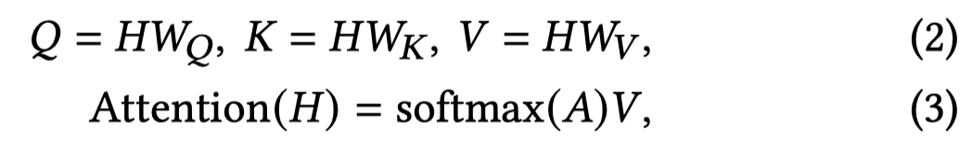
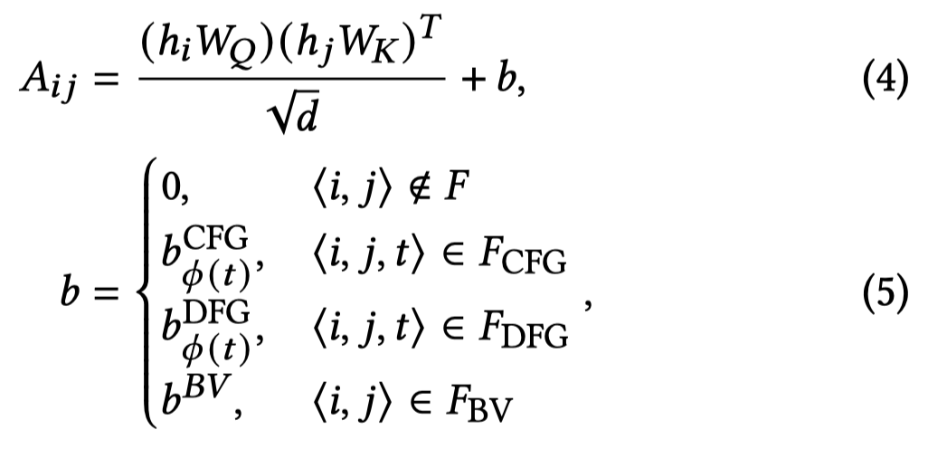
Model Architecture
Graph Transformer Encoder
Biased Self-Attention
Notes:
图2是一个class skeleton的示例。

Slide 24
FAIR
Flow type-Aware code pre-trained model based on IR
Input Representation
CFG, DFG, BB-Var Flows
Model Architecture
Node Embedding, Encoder
Pre-training Tasks
MLM, CFG/DFG Flow Type Prediction, Contrastive Learning
👈

Slide 25
Pre-training Task ①
Masked Language Modeling
Only for Node Embedding Layer (CFGs)
15% of tokens -> [MASK], 80% of tokens remains, 10% of tokens -> a random token
Objective: Predict the masked tokens
Notes:
图2是一个class skeleton的示例。

Slide 26
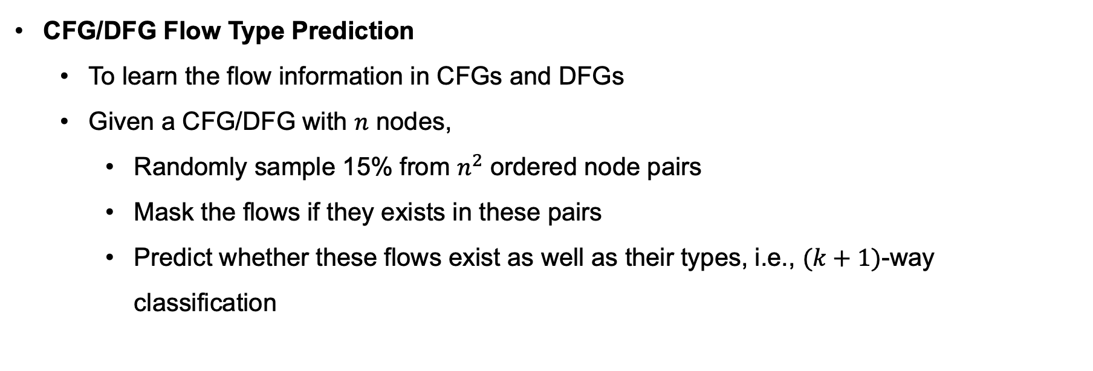
Pre-training Task ② and ③
CFG/DFG Flow Type Prediction
To learn the flow information in CFGs and DFGs
Given a CFG/DFG with $n$ nodes,
Randomly sample 15% from $n^{2}$ ordered node pairs
Mask the flows if they exists in these pairs
Predict whether these flows exist as well as their types, i.e., $(k+1)$-way classification
Notes:
图2是一个class skeleton的示例。

Slide 27
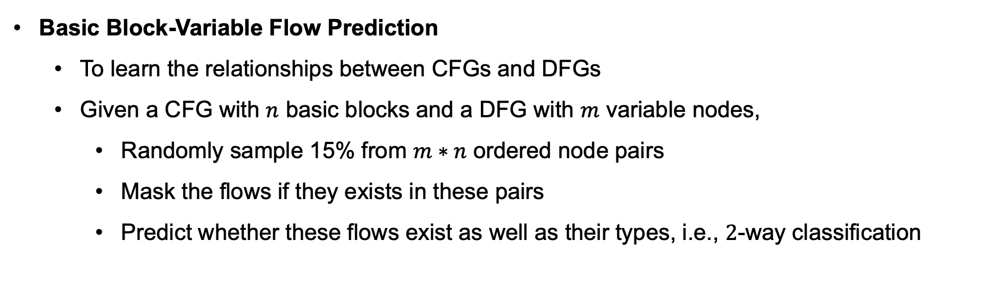
Pre-training Task ④
Basic Block-Variable Flow Prediction
To learn the relationships between CFGs and DFGs
Given a CFG with $n$ basic blocks and a DFG with $m$ variable nodes,
Randomly sample 15% from $m∗n$ ordered node pairs
Mask the flows if they exists in these pairs
Predict whether these flows exist as well as their types, i.e., $2$-way classification
Notes:
图2是一个class skeleton的示例。

Slide 28
Pre-training Task ⑤
Contrastive Learning
Lean representations of an input by contrasting its positive & negative examples
Notes:
图2是一个class skeleton的示例。

Slide 29
Pre-training Task ⑤
Contrastive Learning
Lean representations of an input by contrasting its positive & negative examples
Positive Examples
Function Permutation: change the order of functions
Function Down-sampling: remove one or more functions
Flow Mutation: add/remove/change flows
Node Adding/Removing: add standalone nodes/remove some nodes with flows
Negative Examples
Other samples in training mini-batchs
Notes:
图2是一个class skeleton的示例。

Slide 30
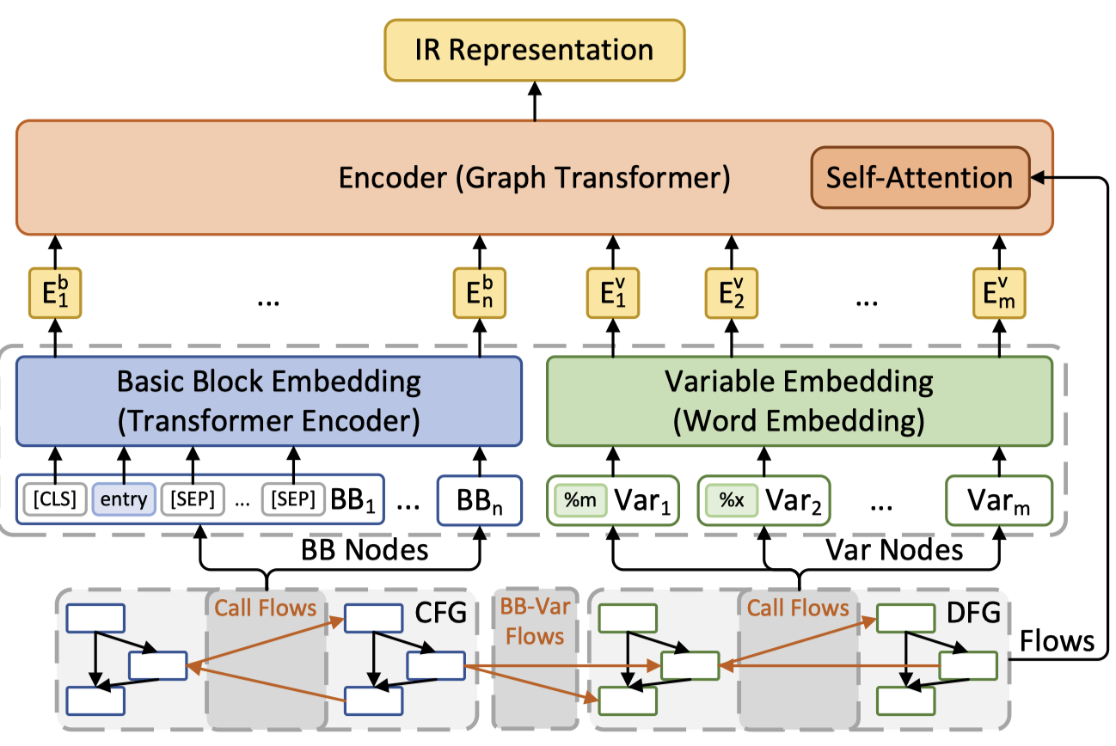
Pre-training Task
CFG/DFG Flow Type Prediction, BB-Var Flow Prediction, Contrastive Learning
Masked Language Modeling
Notes:
图2是一个class skeleton的示例。

Slide 31
Evaluation Setup
Pre-training
Data
Peng et al. (ICML 2021), 11 open-source C/C++ projects
41, 322 IR programs, 855, 792 functions, and 48, 023, 781 instructions
Optimize IRs using LLVM 13.0.1
Tokenizer
A new BPE tokenizer of size 30,000 trained upon the pre-training data
Parameters
108 millions, 10 epochs, batch size 8
Notes:
图2是一个class skeleton的示例。

Slide 32
Evaluation Setup
Downstream Tasks
Code-to-Code Retrieval
POJ-104 (Mou et al. AAAI 2016)
GCJ (Available in Github)
Metric: MAP@R
Algorithm Classification
POJ-104
Metric: Error rate
Notes:
图2是一个class skeleton的示例。

Slide 33
Evaluation Setup
Downstream Tasks
Heterogeneous Device Mapping
Given a C program, predict its execution device with the best performance
A binary classification task (Intel CPU or GPU)
Metric: Accuracy, Speedup
Optimal Thread Coarsening Factor
Given a OpenCL code, predict the best-performing thread nums
A 6-way classification task (1, 2, 4, 8, 16, and 32)
Metric: Speedup
Notes:
图2是一个class skeleton的示例。

Slide 34
Evaluation Setup
Baselines
Source-Code-based Models
CodeBERT, CodeT5, UniXcoder
IR-based Models
Ncc, IR2VEC, GNN-CDFG, ProGraML, OSCAR, IRGen
Notes:
图2是一个class skeleton的示例。

Slide 35
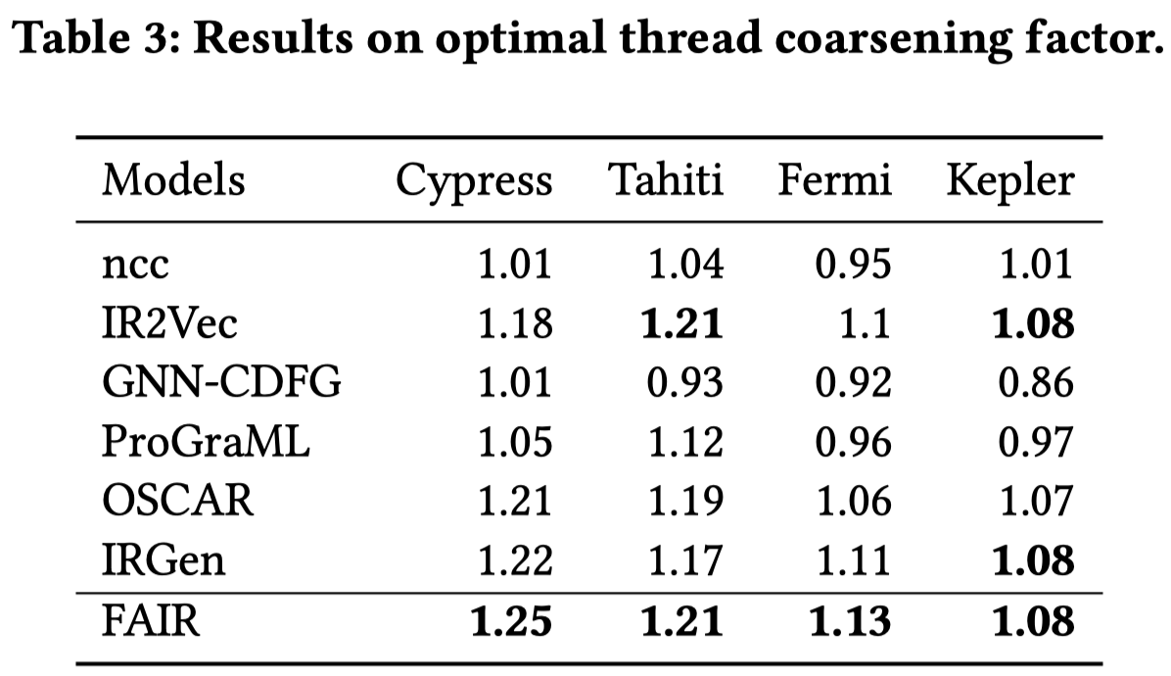
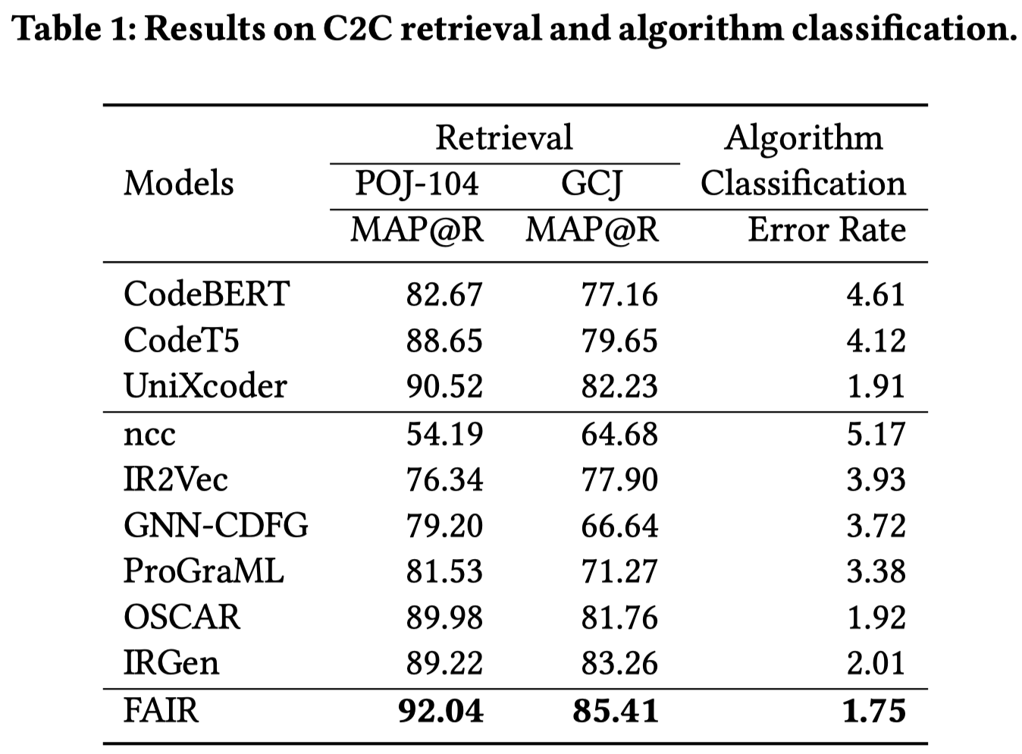
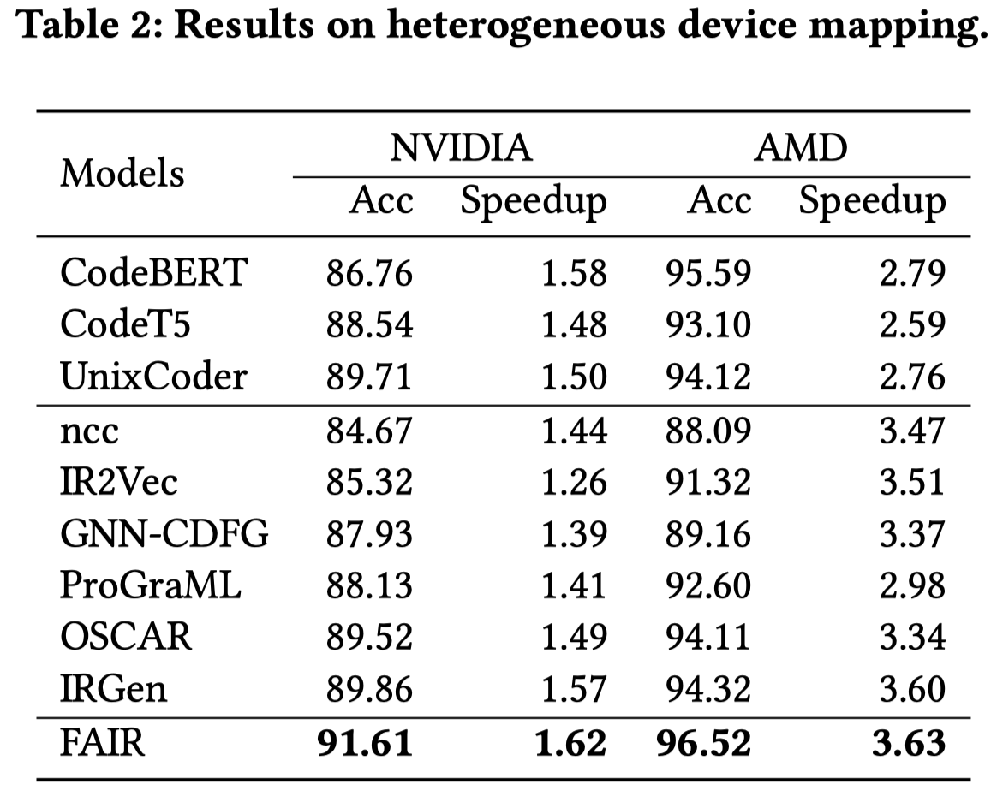
Results and Discussion
RQ1: FAIR vs. Baselines on downstream tasks
Notes:
图2是一个class skeleton的示例。

Slide 36
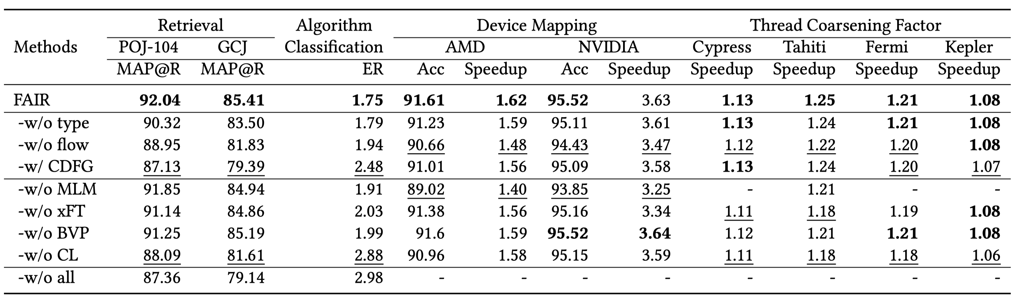
Results and Discussion
RQ2: Model Ablation

Slide 37
Results and Discussion
RQ2: Model Ablation
Flow types
Biased self-attention

Slide 38
Results and Discussion
RQ2: Model Ablation
Pre-training Tasks

Slide 39
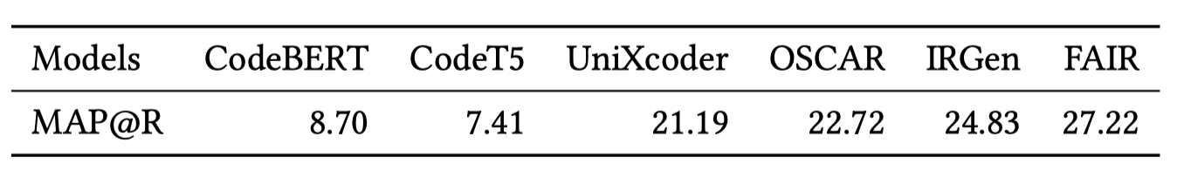
Results and Discussion
RQ3: Transferability
Pre-training: C/C++
Zero-shot Code-to-Code Retrieval
Rust

Slide 40
Conclusion
Advantage
A solid advance on IR representation models
Input Representation and Pre-training Tasks
Weakness
IRs vs. Source Code
Lack of natural language understanding

